Slide 1
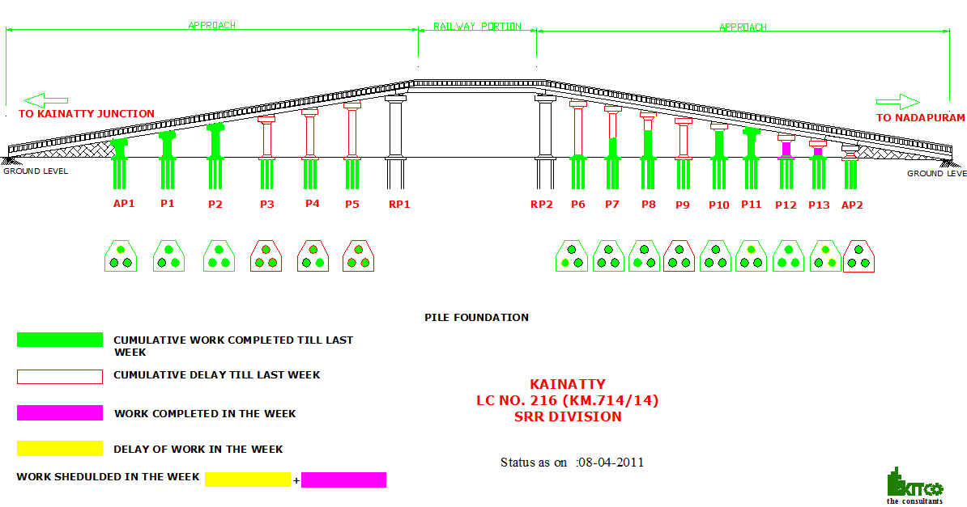
ROB at Kainatti Progress as on 08/04/11

